Slide 1
Customer Personality Analysis
Mennatallah EL-Khateeb
Customer Personality Analysis is a detailed analysis of a company’s ideal customers. It helps a business to understand its customers better and makes it easier for them to modify products according to the specific needs, behaviors, and concerns of different types of customers

Slide 2
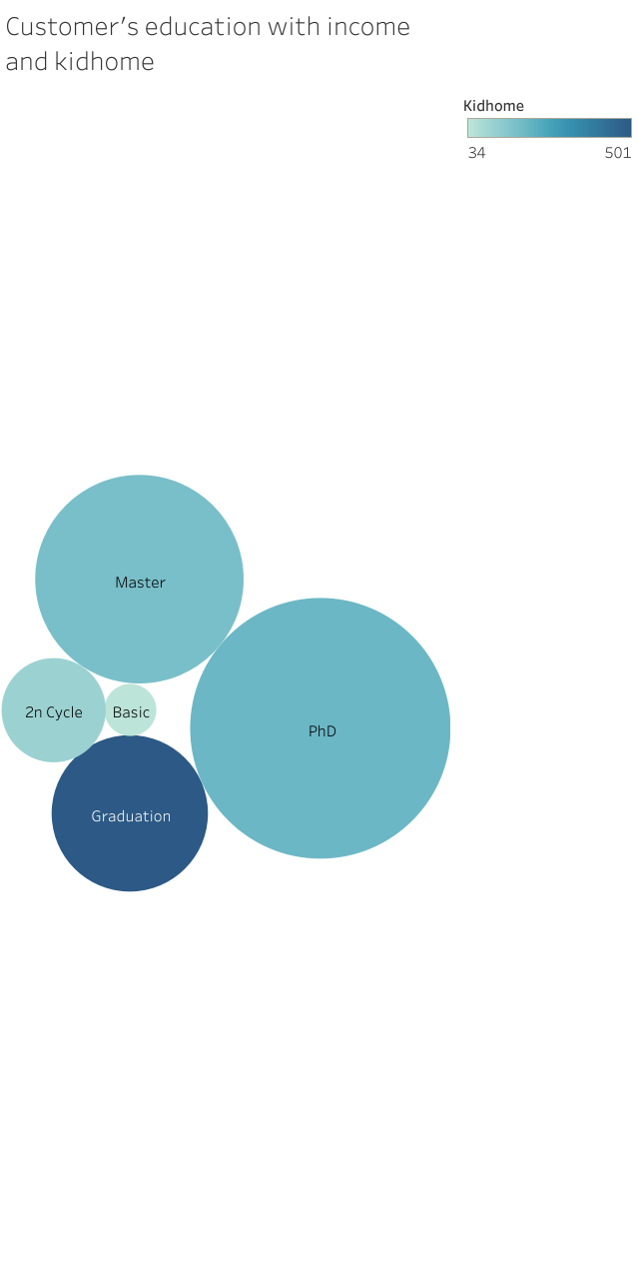
The impact of education on income and having a kid home
There is an increase in income for those with a doctoral degree, and graduates are more likely to have a child.

Slide 3
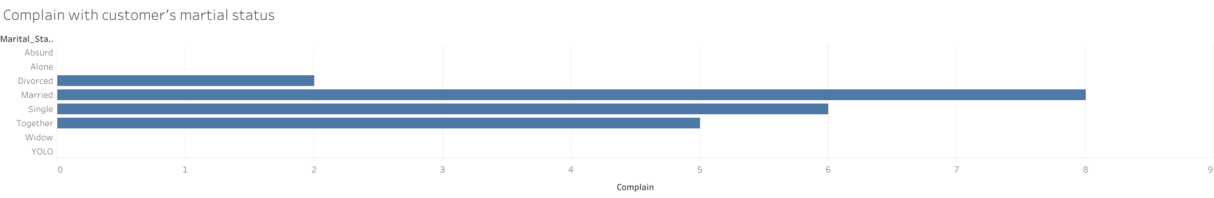
Marital status and number of complaints
It is observed that the majority of complaints come from married and single individuals.

Slide 4
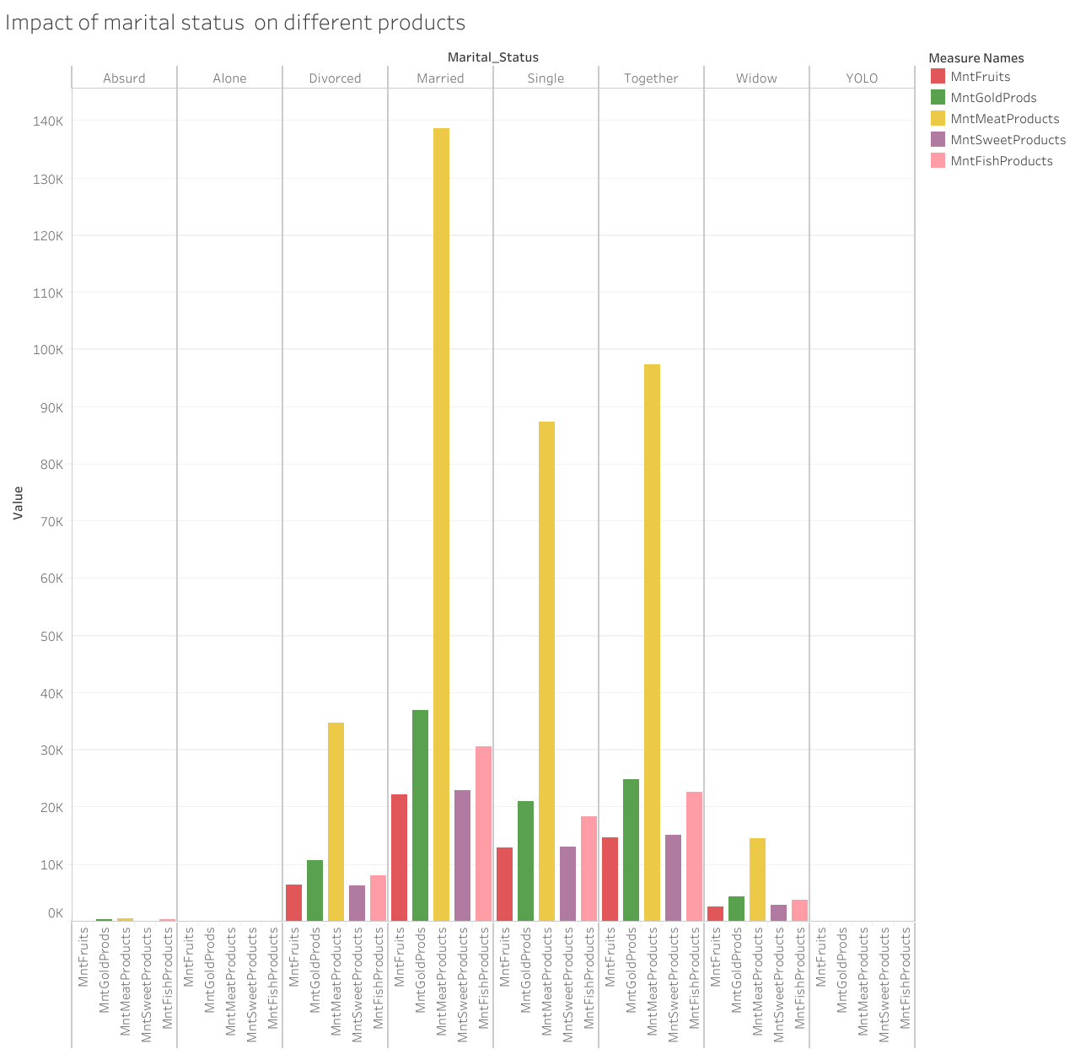
Impact of marital status on different products
It is observed that the most purchased products by married individuals are meat and gold.
It is observed that the most purchased product across different marital statuses is meat, followed by gold.

Slide 5
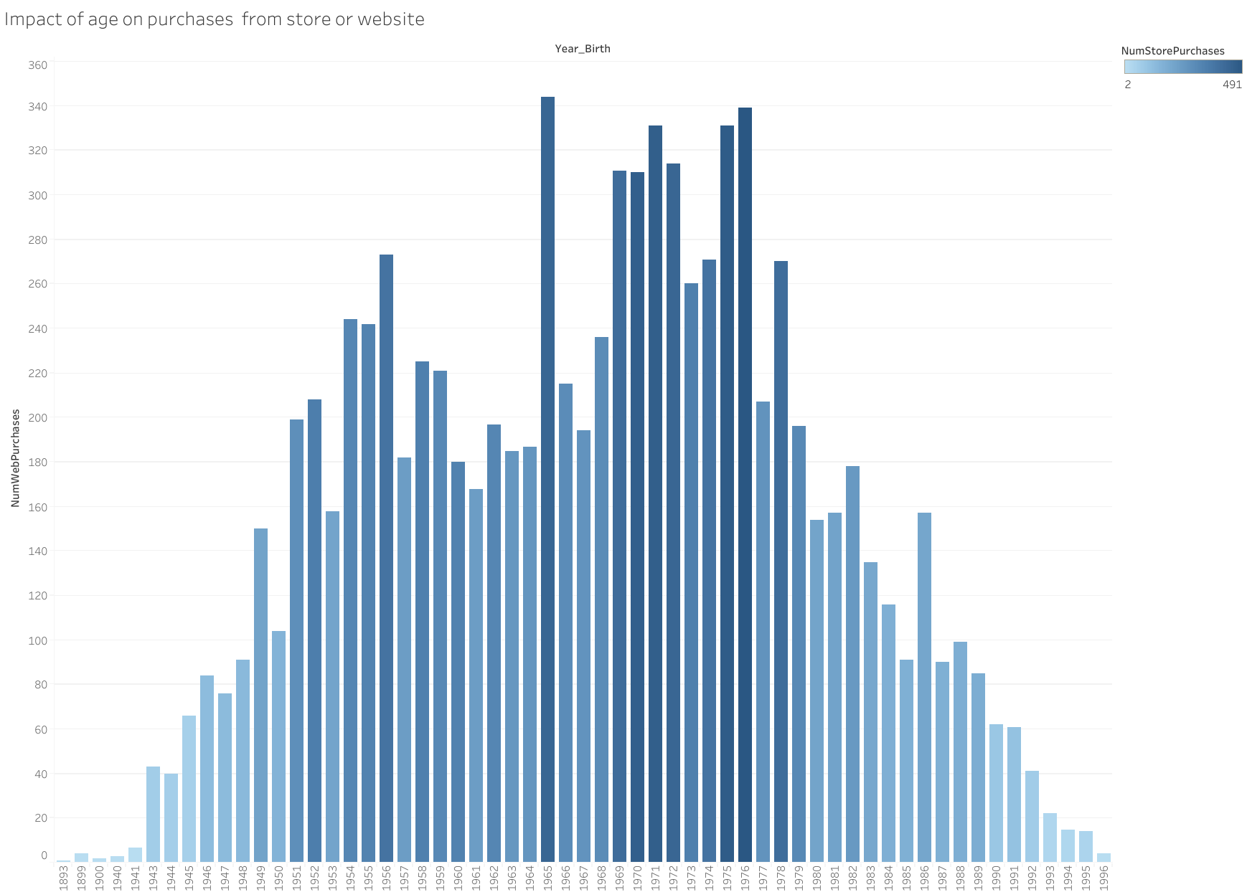
It is noted that customers born in 1965 and 1976 are the most frequent clients interacting with the company, whether through the store or online.
It is observed that younger individuals are the least likely to make purchases from the store.

Slide 6
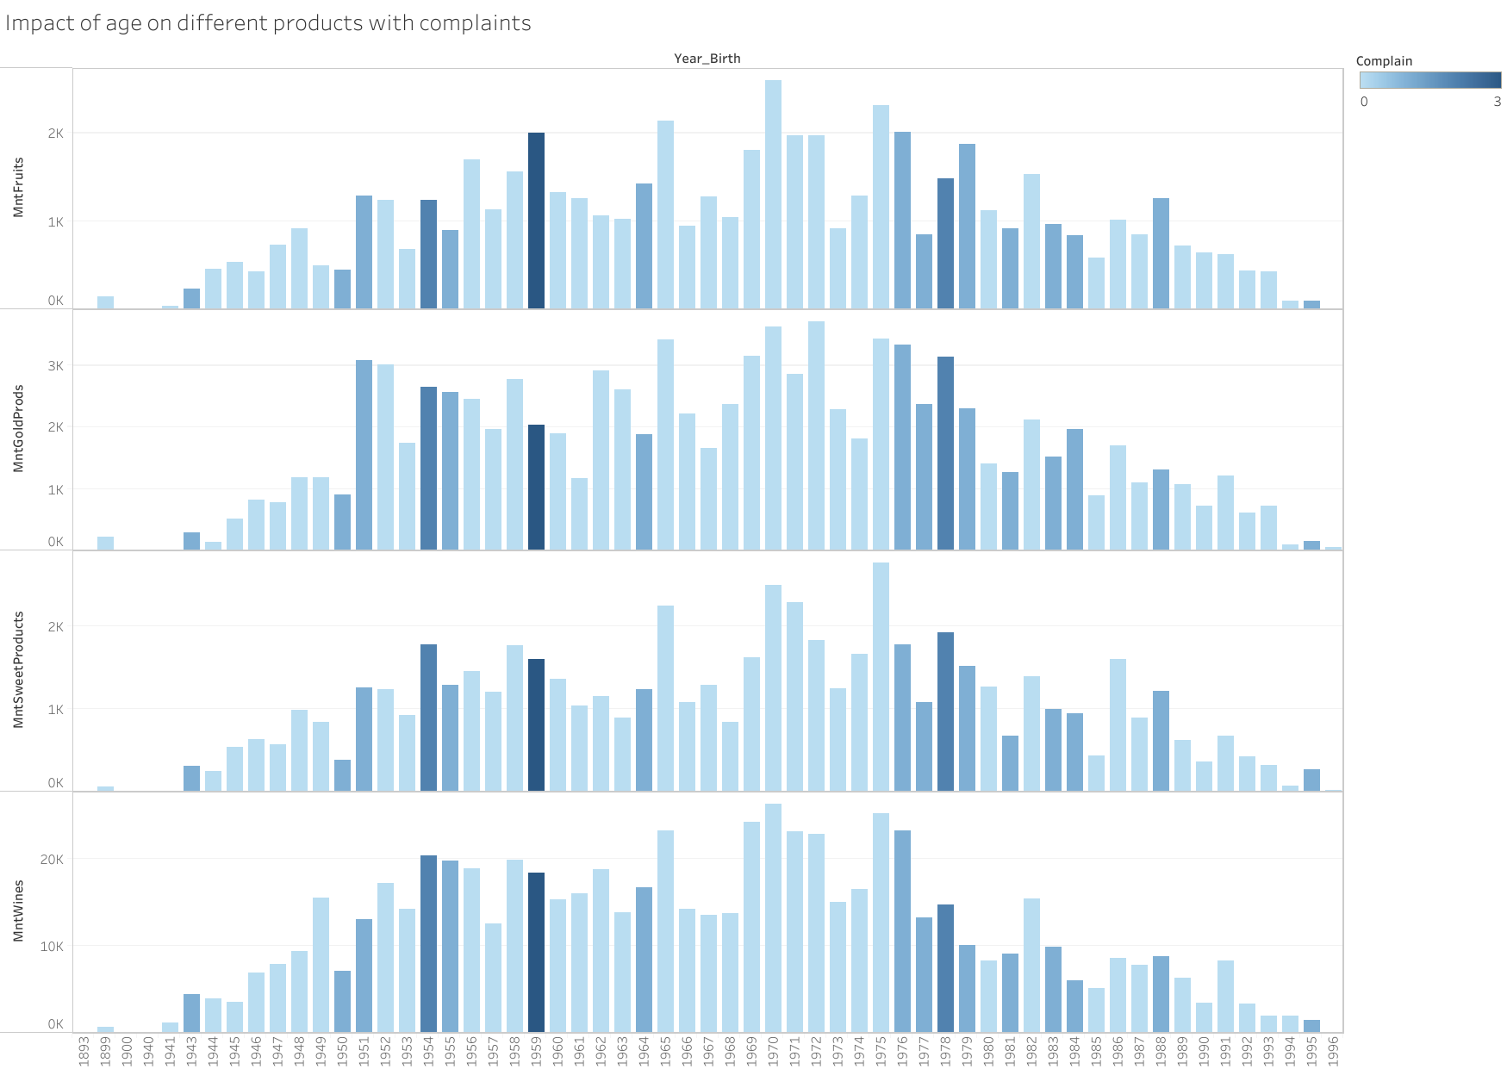
It is observed that individuals born in 1959 are the most frequent complainants across all types of products.
It is observed that age has an impact on the complaints submitted regarding different products.

Slide 7
